Slide 1

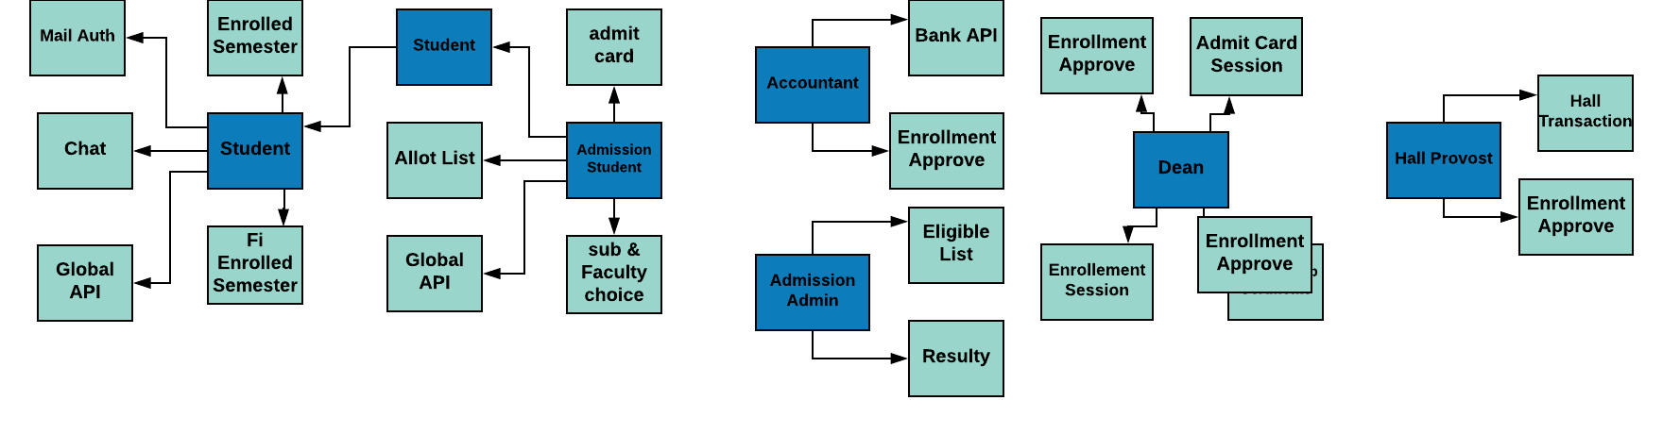
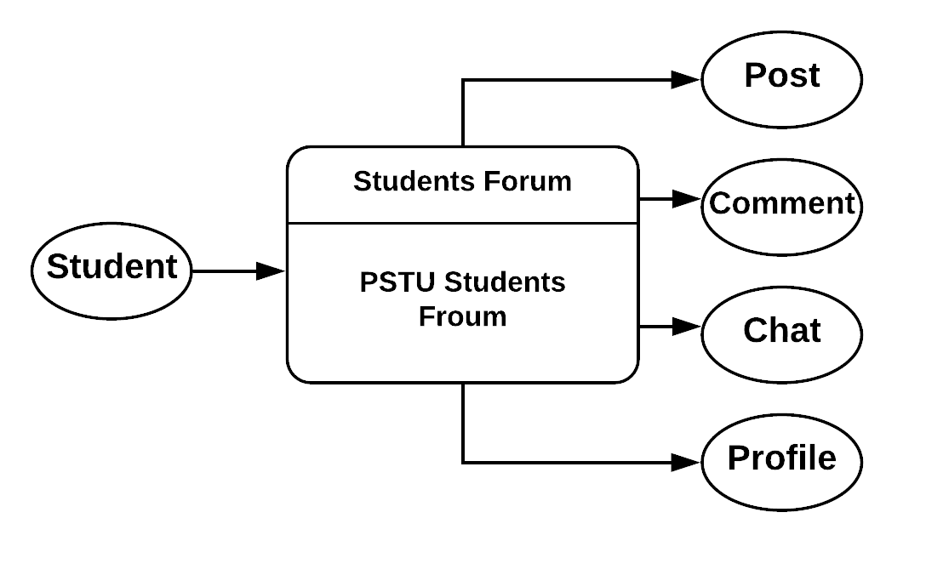
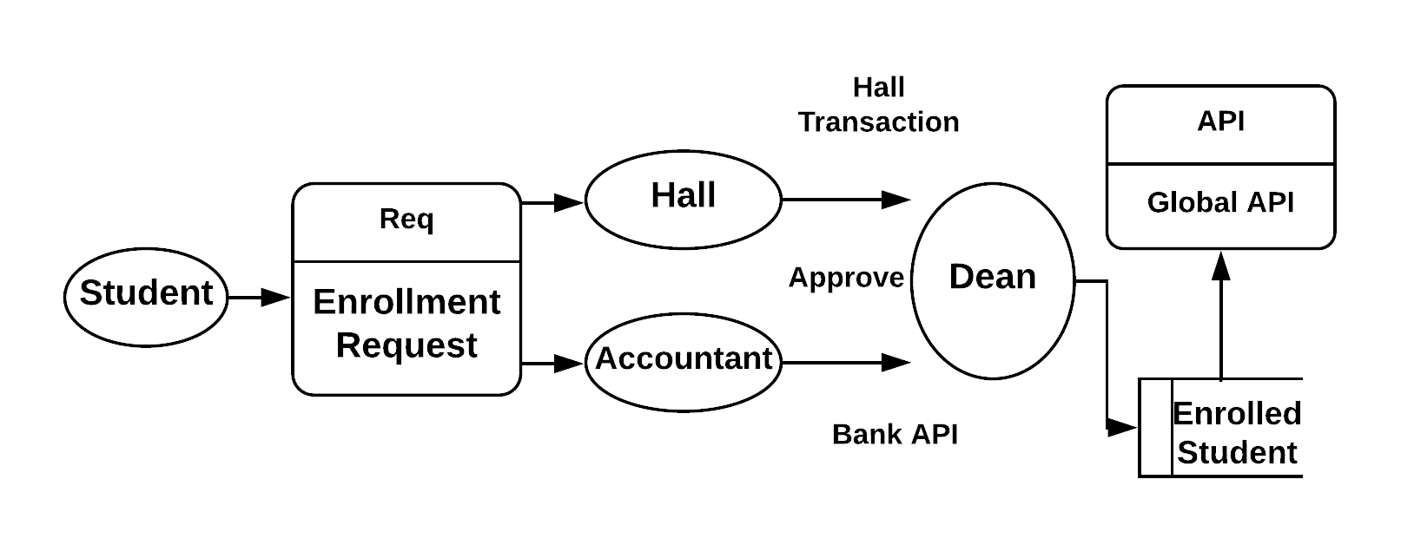
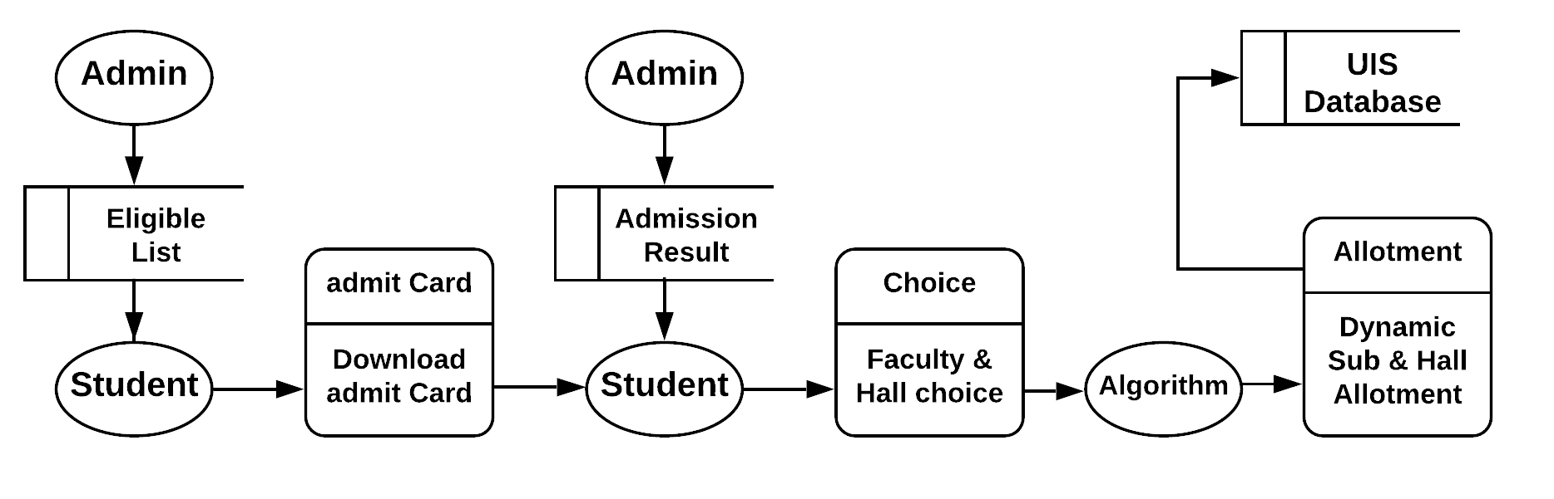
PSTU Information System
Md. Inzamul Islam Ricky (1302004) mdrickyislam.cse@gmail.com
Background Portion:
Step 2:
Relationship Between Entities
Entities interacting with UIS system (with role):
Student:
1) Enrollment Request & View approval
2) Students Forum
(b) Dean:
1) Enrollment Approval
2) Control enrollment & admit card session
(c) Account Officer:
1) Enrollment Approval by checking the transaction detail provided by bank API
(d) Hall Provost:
1) Enrollment Approval
2) Control enrollment & admit card session
(e) Applicant:
1) Providing detail & download admit card
2) Faculty & hall Choice (For eligible students)
(f) Admission admin:
1)Upload eligible list and admission results.
2)Dynamically allocated ‘allocation list’ and registering students with UIS database.
Step 3:
Control Flow Diagram
Student’s Forum:
Project Modules:
Mail Authenticated Security
Students Discussion Forum
Live Chatting with admin
Enrollment Module (Regular Courses)
Enrollment Module (FI Courses)
Download .pdf Admit Card
Hall Provost (Auth. Based on Transaction)
Account Officer (Auth. Based On Bank API)
Dean Office (Auth. & control admit card and enrollment session)
Admission (Student)
Admission (Admin)
Enrollment Module:
Admission Module:
Methodology:
Step 1:
Analysis of:
Bangladesh University Of Engineering & Technology (BUET) Information System.
PSTU semester enrollment and admission system
Conclusion:
What has been done:
An ‘approval’ based enrollment system where student’s can get his admit card from home.
A Social sharing module for the website.
The whole admission process is integrated with the UIS core system
Global API for sharing information with security.
What will be done:
1. Enrollment system with need to be specified for all the faculties.
2. Enriching Dean Office, Account Officer and Hall Provost’s functionality
3. Involving Teacher’s functionality in PIS Website.
Application:
1. Lessen the burden of Enrollment Process.
2. An organized way to store and sharing information
3. UIS integrated admission module.
Faculty of Computer Science and Engineering (CSE), PSTU
cse.pstu.ac.bd

